Slide 1
MPSS – The Software Stack
Ravi Murty, Intel
ravi.murty@intel.com

Slide 2
Legal Disclaimer
INFORMATION IN THIS DOCUMENT IS PROVIDED IN CONNECTION WITH INTEL® PRODUCTS. NO LICENSE, EXPRESS OR IMPLIED, BY ESTOPPEL OR OTHERWISE, TO ANY INTELLECTUAL PROPETY RIGHTS IS GRANTED BY THIS DOCUMENT. EXCEPT AS PROVIDED IN INTEL’S TERMS AND CONDITIONS OF SALE FOR SUCH PRODUCTS, INTEL ASSUMES NO LIABILITY WHATSOEVER, AND INTEL DISCLAIMS ANY EXPRESS OR IMPLIED WARRANTY, RELATING TO SALE AND/OR USE OF INTEL® PRODUCTS INCLUDING LIABILITY OR WARRANTIES RELATING TO FITNESS FOR A PARTICULAR PURPOSE, MERCHANTABILITY, OR INFRINGEMENT OF ANY PATENT, COPYRIGHT OR OTHER INTELLECTUAL PROPERTY RIGHT.
Intel may make changes to specifications and product descriptions at any time, without notice.
All products, dates, and figures specified are preliminary based on current expectations, and are subject to change without notice.
Intel, processors, chipsets, and desktop boards may contain design defects or errors known as errata, which may cause the product to deviate from published specifications. Current characterized errata are available on request.
Sandy Bridge and other code names featured are used internally within Intel to identify products that are in development and not yet publicly announced for release. Customers, licensees and other third parties are not authorized by Intel to use code names in advertising, promotion or marketing of any product or services and any such use of Intel's internal code names is at the sole risk of the user
Software and workloads used in performance tests may have been optimized for performance only on Intel microprocessors. Performance tests, such as SYSmark and MobileMark, are measured using specific computer systems, components, software, operations and functions. Any change to any of those factors may cause the results to vary. You should consult other information and performance tests to assist you in fully evaluating your contemplated purchases, including the performance of that product when combined with other products. For more information go to http://www.intel.com/performance
Intel, Core, Xeon, VTune, Cilk, Intel and Intel Sponsors of Tomorrow. and Intel Sponsors of Tomorrow. logo, and the Intel logo are trademarks of Intel Corporation in the United States and other countries.
*Other names and brands may be claimed as the property of others.
Copyright ©2011 Intel Corporation.
Hyper-Threading Technology: Requires an Intel® HT Technology enabled system, check with your PC manufacturer. Performance will vary depending on the specific hardware and software used. Not available on all Intel® Core™ processors. For more information including details on which processors support HT Technology, visit http://www.intel.com/info/hyperthreading
Intel® 64 architecture: Requires a system with a 64-bit enabled processor, chipset, BIOS and software. Performance will vary depending on the specific hardware and software you use. Consult your PC manufacturer for more information. For more information, visit http://www.intel.com/info/em64t
Intel® Turbo Boost Technology: Requires a system with Intel® Turbo Boost Technology capability. Consult your PC manufacturer. Performance varies depending on hardware, software and system configuration. For more information, visit http://www.intel.com/technology/turboboost

Slide 3


Agenda
Section 1: The System SW Stack
Card OS
Symmetric Communications Interface (SCIF)
Code Examples
Section 2: Compiler Runtimes
Coprocessor Offload Infrastructure (COI)
Code Examples
Section 3: Coprocessor Communication Link (CCL)
IB-SCIF
CCL Direct and Proxy
MPI Dual-DAPL
Section 4: Heterogeneous Programming with Offload
Code Examples
iXPTC 2013
Intel® Xeon Phi ™Coprocessor

Slide 4
Intel® Xeon Phi™ Coprocessor Arch – System SW Perspective
Large SMP UMA machine – a set of x86 cores to manage
4 threads and 32KB L1I/D, 512KB L2 per core
Supports loadable kernel modules – we’ll talk about one today
Standard Linux kernel from kernel.org
2.6.38 in the most recent release
Completely Fair Scheduler (CFS), VM subsystem, File I/O
Virtual Ethernet driver– supports NFS mounts from Intel® Xeon Phi™ Coprocessor
New vector register state per thread for Intel® IMCI
Supports “Device Not Available” for Lazy save/restore
Different ABI – uses vector registers for passing floats
Still uses the x86_64 ABI for non-float parameter passing (rdi, rsi, rdx ..)
iXPTC 2013
Intel® Xeon Phi ™Coprocessor

Slide 5
Card OS

Slide 6
Card OS
Bootstrap
Memory training
Build MP Table, e820 map, load image in memory (bzImage)
Jump to 32-bit protected mode entry point in the kernel
It’s just Linux with some minor modifications:
IPI format, local APIC calibration, no support for compatibility mode (CSTAR)
No global bit in PTE/PDE entries.
IOAPIC programmed via MMIO
Instructions not supported: cmov, in/out, monitor/mwait, fence
No support for MMX/SSE registers
Save/restore of vector state via DNA (CR0.TS=1)
iXPTC 2013
Intel® Xeon Phi ™Coprocessor

Slide 7
Execution Modes
Intel ® Xeon Phi™
Coprocessor
Intel® Xeon Phi™
Coprocessor
Intel® Xeon
Intel® Xeon
main()
main()
main()
foo()
Native
Offload
Card is an SMP machine running Linux
Separate executables run on both MIC and Xeon
e.g. Standalone MPI applications
No source code modifications most of the time
Recompile code for Xeon Phi™ Coprocessor
Autonomous Compute Node (ACN)
“main” runs on Xeon
Parts of code are offloaded to MIC
Code that can be
Multi-threaded, highly parallel
Vectorizable
Benefit from large memory BW
Compiler Assisted vs. Automatic
#pragma offload (…)
iXPTC 2013
Intel® Xeon Phi ™Coprocessor

Slide 8
Native is Easy
Cross compile your application for k1om arch
Intel C/C++ and Fortran compiler, k1om aware GCC port.
Binutils for k1om e.g. objdump
LSB – glibc, libm, librt, libcurses etc.
Busybox – minimal shell environment
Virtual Ethernet driver allows:
ssh, scp
NFS mounts
You still have to spend time parallelizing and vectorizing your application for performance on Intel® Xeon Phi™ Coprocessor
iXPTC 2013
Intel® Xeon Phi ™Coprocessor

Slide 9
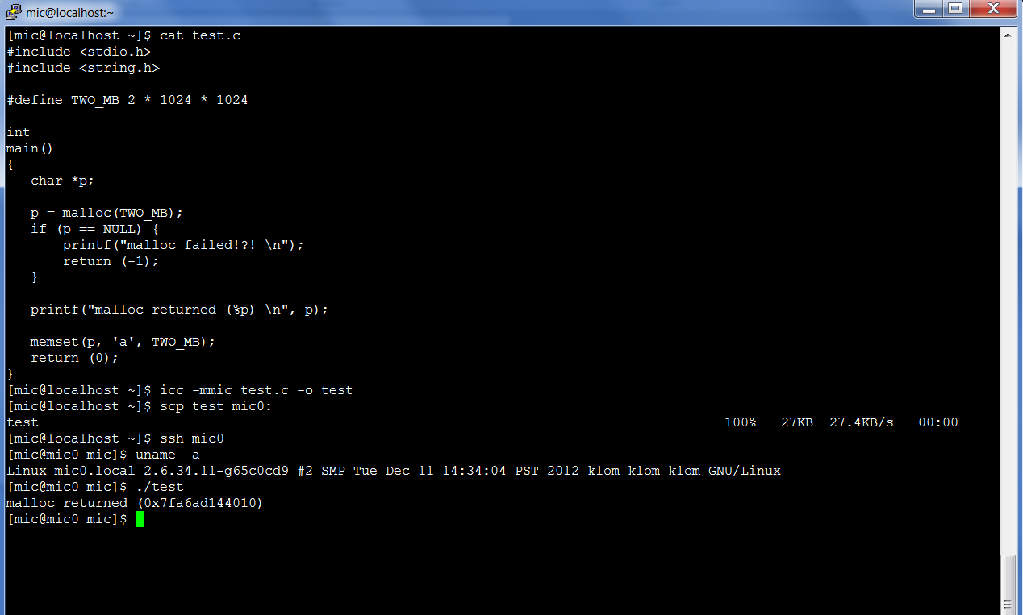
“Hello World”
iXPTC 2013
Intel® Xeon Phi ™Coprocessor

Slide 10
Performance Considerations for Native
Single vs. Multi-threaded applications
Scalability is important
Scalar vs. Vector code
Explicit cache management
SW prefetching and evicting
 | Frequency | cores | vector width
Xeon | 2.6 | 16 | 8
Xeon Phi™ Coprocessor | 1.09 | 61 | 16
Intel® Xeon Phi™ Coprocessor has a Fused Multiply Add (FMA) for 2x flops/cycle
log scale
Peak flops (Gflop/s)
iXPTC 2013
Intel® Xeon Phi ™Coprocessor

Slide 11
DMA alignment results
Case1: CA
Case2: CU + MA (16, 272)
8K – 6.7 GB/s
8K – 3.4 GB/s
16 K – 6.8 GB/s
16 K – 5.9 GB/s
Case3: CU + MU (16, 84)
(x, y) – x = source offset, y = destination offset
CA – Cacheline Aligned
CU – Not Cacheline Aligned
MA – Mutually Aligned between source and destination buffers
MU – Mutually Mis-aligned between source and destination buffers
8K – 0.95 GB/s
16 K – 1.6 GB/s
iXPTC 2013
Intel® Xeon Phi ™Coprocessor
Source: Michael Carroll, MPSS Team

Slide 12
Coprocessor Offload Infrastructure (COI)
iXPTC 2013
Intel® Xeon Phi ™Coprocessor

Slide 13
Card OS

Slide 14
COI Introduction
COI provides a set of APIs to simplify development for tools/apps using offload accelerator models
Simplifies running application on the Intel® Xeon Phi™ Coprocessor
Loading and launching device code without needing SSH passwords, NFS mounts, etc.
Simplifies asynchronous execution and data transfer
Can set up dependencies between asynchronous code execution and data movement
Device parallelism keeps the host, DMA engines and Phi device busy at the same time
Simplifies Resource Management
Automatically manages buffer space by reserving memory and evicting data as needed
Simplest way to get the best performance
COI includes features such as pinned buffers and same address buffers which make it easy to offload existing applications
iXPTC 2013
Intel® Xeon Phi ™Coprocessor

Slide 15
COI Terminology
COI allows commands to be sent from a “source” to a “sink”
Commands are asynchronous function invocations (“run functions”)
“Source” is where “run functions” are initiated
“Sink” is where “run functions” are executed
A typical COI application is comprised of a source application and a sink offload binary
The sink binary is a complete executable
Not just a shared library
Starts executing from main when it is loaded
COI automatically loads dependent libraries prior to starting the offload binary on the sink
COI has a coi_daemon that spawns sink processes and waits for them to exit
source
Xeon
Xeon Phi™
Coprocessor
sink
forward
offload
iXPTC 2013
Intel® Xeon Phi ™Coprocessor

Slide 16
Host and Device Parallelism with COI
This of the instruction execution pipeline - Hennessy and Patterson
Host Compute
DMA to Device
Device Compute
DMA to Host
Host Compute
DMA
to Device
(if necessary)
Host Compute
DMA to Device
Device Compute
DMA to Host
Host Compute
Host, device, and DMA all busy at the same time!
Host Compute
DMA to Device
Device Compute
DMA to Host
Host Compute
DMA to Device
Device Compute
iXPTC 2013
Intel® Xeon Phi ™Coprocessor

Slide 17
COI APIs – First glance
COI exposes four major abstractions:
Use the simplest layer or add additional capabilities with more layers as needed
Each layer intended to interoperate with other available lower layers (e.g. SCIF)
Enumeration: COIEngine, COISysInfo
Enumerate HW info; cards, APIC, cores, threads, caches, dynamic utilization
Process Management: COIProcess (requires COIEngine)
Create remote processes; loads code and libraries, start/stop
Execution Flow: COIPipeline (requires COIProcess)
COIPipelines are the RPC-like mechanism for flow control and remote execution
Can pass up to 32K of data with local pointers
Data and Dependency Management: COIBuffer, COIEvent (requires COIPipeline)
COIBuffers are the basic unit of data movement and dependence managment
COIEvent optionally used to help manage dependences
COIBuffers and COIEvents are typically used with Run Functions executing on COIPipelines
iXPTC 2013
Intel® Xeon Phi ™Coprocessor

Slide 18
API: COIEngine
Abstracts the devices in the system
Host x86_64 device as well as Phi cards
Provides device enumeration capabilities
Number of devices and handles to devices
Also provides dynamic device information
Current memory utilization and CPU load
Does not require any other COI APIs
/* Get the number of engines */
uint32_t num_engines = 0;
COIEngineGetCount(COI_ISA_MIC, /* The type of engine. */
&num_engines); /* Outparam for number of engines */
/* of this type. */
/* Get a handle to the first one */
COIENGINE engine;
COIEngineGetHandle(COI_ISA_MIC, /* The type of engine.
0, /* The index of the engine within
* the array of engines of this type
*/
&engine); /* Outparam for the engine handle */
iXPTC 2013
Intel® Xeon Phi ™Coprocessor

Slide 19
Coprocessor Communication Link (CCL)
iXPTC 2013
Intel® Xeon Phi ™Coprocessor

Slide 20
Card OS

Slide 21
Introduction
OFED is the industry standard code used for messaging on high-end HPC clusters
Supports Intel MPI and all open source MPIs
Is in Linux and all the various Linux distributions
RDMA over SCIF (IB-SCIF) – RDMA within the platform between the host and KNC or multiple KNCs
Intel ® Xeon Phi ™ Coprocessor Communication Link (CCL) Direct
Direct access to InfiniBand HCA from Intel® Xeon Phi ™
Lowest latency data path
Intel ® Xeon Phi ™ Coprocessor Communication Link (CCL) Proxy
Pipeline data through host memory to InfiniBand network
Higher bandwidth data path for some platform configurations
Intel MPI dual-DAPL support
Uses best data path, direct path for small messages, and proxy path for large messages for best overall MPI performance
iXPTC 2013
Intel® Xeon Phi ™Coprocessor

Slide 22
RDMA over IB-SCIF
OFED for Intel® Xeon Phi™ Coprocessor uses the core OFA software modules from the Open Fabrics Alliance
IB-SCIF is a new hardware specific driver and library that plugs into the OFED core mid-layer
SCIF is the lowest level in the SW stack as we saw earlier
Provides standard RDMA verbs interfaces within the platform, i.e., between the Intel® Xeon™ and Intel® Xeon Phi ™ Coprocessor cards within the same system.
IBSCIF 1 byte latency is in the 13us range, (host-KNC), peak BW is in the 6GB/s per sec. range
Xeon Host /Xeon Phi
iXPTC 2013
Intel® Xeon Phi ™Coprocessor

Slide 23
Intel® Xeon Phi ™ Coprocessor CCL Direct Software
CCL-Direct
Allows access to an HCA directly from the Xeon Phi™ Coprocessor using standard OFED interfaces using PCI-E peer-to-peer transactions
Provides the lowest latency data path
For each hardware HCA, a unique vendor driver has to be developed.
e.g., mlx4, mthca, Intel® True Scale ™ hca etc
Currently support for Mellanox HCAs (mlx4) exists and is shipping in MPSS
Support for Intel® TrueScale™ InfiniBand NICs via PSM is under development, expected release in early 2013
Implementation Limitations
Intel® Xeon Phi™ Coprocessor CCL Direct only supports user space clients, e.g. MPI
Peak bandwidth is limited on some platforms and configurations
CCL-Direct 1 byte latency is in the 2.5us range for Host-KNC, and 3.5-4us range for KNC-KNC across an InfiniBand HCA, peak BW varies depending on the Xeon platform (see later)
iXPTC 2013
Intel® Xeon Phi ™Coprocessor

Slide 24
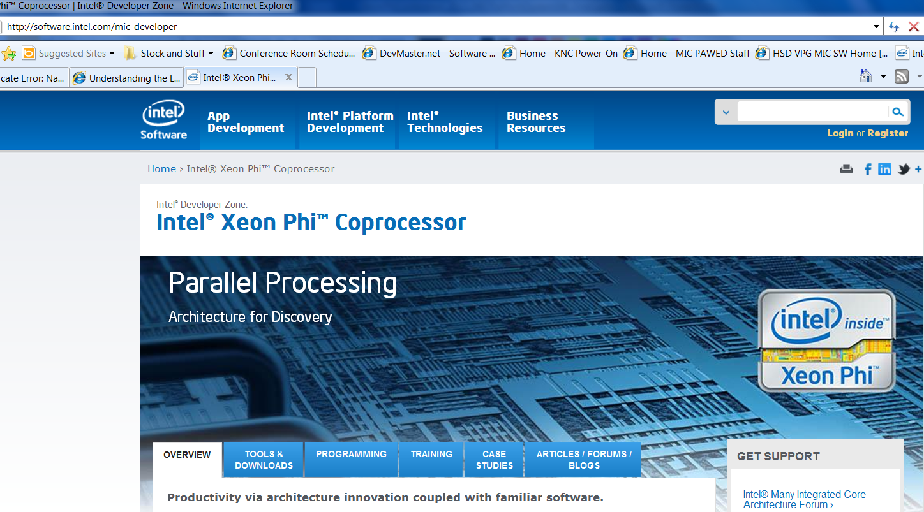

Slide 25
Backup Material

Slide 26
SCIF Backup Material

Slide 27
Connection Process
SCIF connection process is very socket-like
Open an endpoint, ep, and bind it to some port, pn
Mark the port as a listening port
Wait for a connection request, then Accept the connection request and return a new endpoint, nepd
The peer processes can communicate through the completed connection
Open an endpoint, ep, and bind it to some port, pn
Request a connection to port pn on node j Connection is complete on return
The peer processes can communicate through the completed connection

Slide 28
Launching Remote Processes
Connection requires one process to listen and one to request a connection
How do you get a process on a node that will accept your connection request?
Some ports are “well known” and reserved for specific clients
COI, MYO, OFED, RAS, PM, NetDev
Each client typically has a daemon (launched with uOS at R3 or R0)
Other apps can use services such as COI, micnativeloadex, or ssh (over virtual Ethernet) to launch a process on a node

Slide 29
Kernel mode APIs
int scif_pin_pages(void *addr, size_t len, int prot_flags, int map_flags, scif_pinned_pages_t *pinned_pages);
int scif_unpin_pages(scif_pinned_pages_t pinned_pages);
off_t scif_register_pinned_pages( scif_epd_t epd, scif_pinned_pages_t pinned_pages, off_t offset, int map_flags);
int scif_get_pages(scif_epd_t epd, off_t offset, size_t len, struct scif_range **pages);
int scif_put_pages(struct scif_range *pages);
int scif_event_register(scif_callback_t handler);
int scif_event_unregister(scif_callback_t handler);
int scif_pci_info(uint16_t node, struct scif_pci_info *dev);

Slide 30
SCIF APIs at a glance
Endpoint connection:
connection establishment between processes
scif_open(), scif_bind(), scif_listen(), scif_accept(), scif_connect(), scif_close()
Messaging:
send/receive messages between connected endpoints
scif_send(), scif_recv()
A message is an arbitrary sequence of bytes
These APIs are intended to be used for short data transfers e.g. commands
Registration:
Exposes local physical memory for remote access via a local Registered Address Space
scif_register(), scif_unregister()
Mapping:
scif_mmap(), scif_munmap()
Maps remote physical pages into local virtual address space of process

Slide 31
SCIF APIs at a glance (2)
Remote Memory Access (RMA):
Perform DMA or programmed I/O transfers
scif_readfrom(), scif_writeto(), scif_vreadfrom(), scif_vwriteto()
Supports the notion of “one sided communication”
Push or pull data
Supports DMA (for large) or CPU (for small transfers) based transfers
Synchronization:
Enables synchronization with RMA completion, now vs. later
Must comprehend RMAs completing out of order – multiple DMA channels
Scif_fence(), scif_fence_mark(), scif_fence_wait(), scif_fence_signal()
Utility:
scif_get_nodeIDs(), scif_poll(), scif_get_fd()
Requires HW support to make all of this work (and work well)
PCIe accesses
SMPT
Aperture mapped from the host
Interrupts in both directions (ICR and System interrupt registers)

Slide 32
声明：
所有的版权属于原有公司，文件均来自公开渠道
此文件仅供学习使用，任何人不得进行以此为商业目的的行为
如有疑问，请立即删除
学习世界五百强和咨询公司PPT课程请访问如下网站搜索：“司马懿”
百度传课：司马懿PPT学校
https://www.chuanke.com
网易学堂：司马懿PPT学校
https://study.163.com
知乎： 司马懿PPT学校
https://www.zhiu.com

